Slide 1


Data Science Methods and Tools
PRESENTED TO
Dr. Handan Liu
ETF PRICE ANALYSIS
PRESENTED BY
Vidip Kamdar
00270159
Harsh Jain
002747565
Team No - 13
04/21/2023

Slide 2

Agenda
1
Description
2
Methodology
3
Data Cleaning
4
Data Visualization
5
Algorithm
6
Conclusion
7
References

Slide 3

Introduction
Data science is the application of a variety of statistical tools, algorithms, and machine learning approaches to data in order to uncover hidden patterns that can then be transformed into new knowledge.
ETFs represent a cheap alternative to Mutual Funds and they are growing fast in the last years due to their passive approach and the consequential lower fees

Slide 4

Objectives
The whole purpose of the project is to Analyze the changes in the price of ETF.
Analyze the future investment opportunities in ETFs
Predict the closing price of stock using various algorithms and finding the accuracy of the prediction

Slide 5
Motivation
Provide an instance to convince investors to invest in Exchange Traded Funds
Creating a model which can assist in price prediction
Analyzing if Exchange Traded Funds is a beneficial source of investment

Slide 6

Description
· Collecting Data: The data has been gathered from Kaggle, where we retrieved the ETFs.csv dataset and the ETF price.csv dataset
· Importing Data: The dataset is imported by read_csv() function.
· Data Cleaning: Dropped the extra column from ETF prices.csv using drop function.
After dropping the null values merged both the ETFs.csv and ETF prices.csv
·Data Visualization: The dataset is visualized and has been plotted using various columns and attributes.
·Algorithm: Random forest Regressor, Xg Boost, and Gradient Boosting Regressor have been used to check the consistency of the dataset.

Slide 7
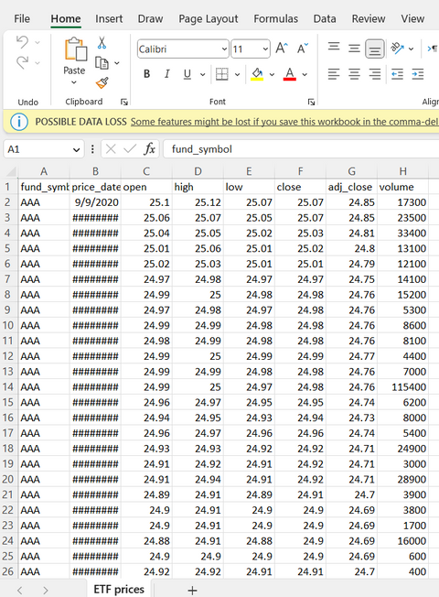
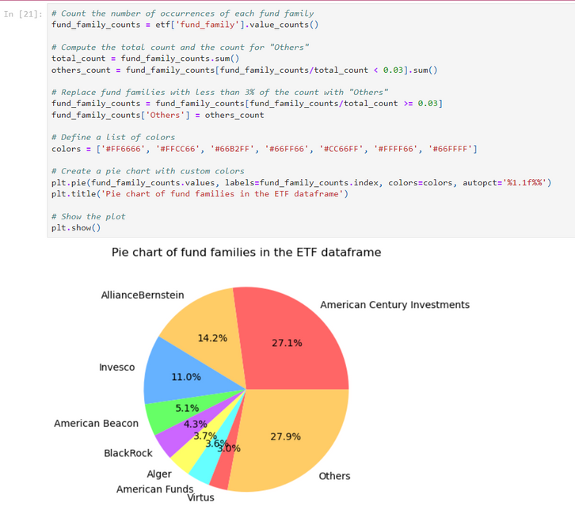
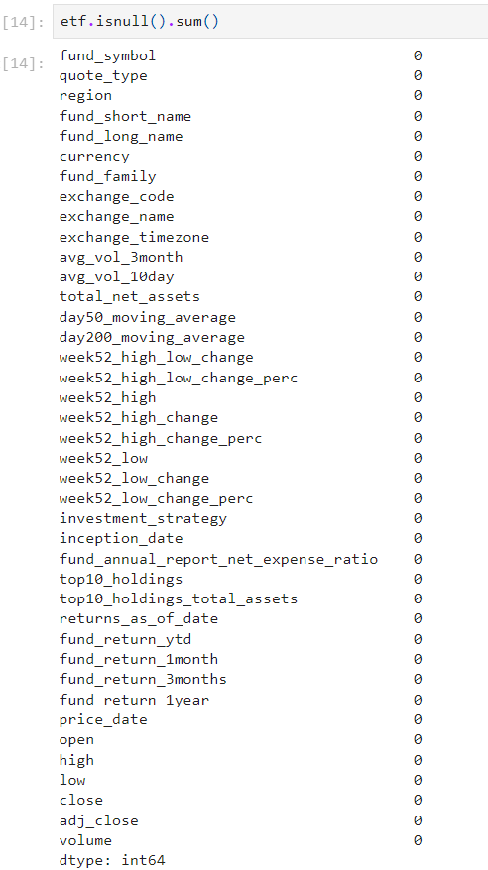
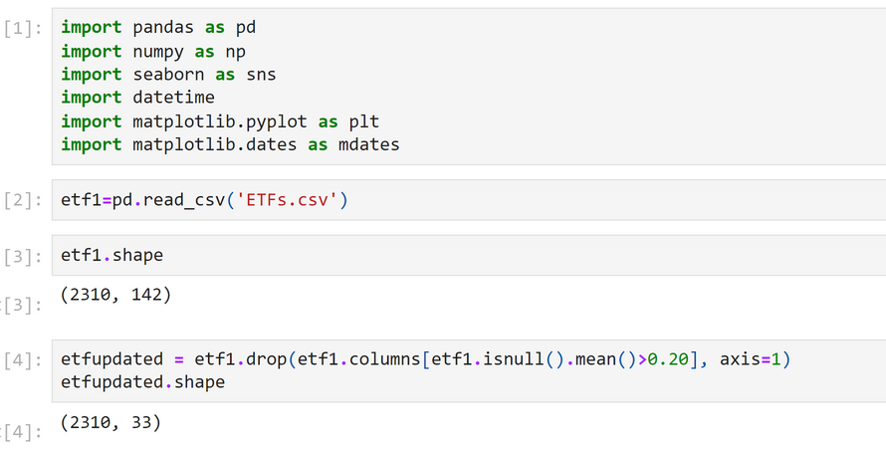
Methodology
Collecting Data
Data Visualization
Importing Data
Data Cleaning

Slide 8
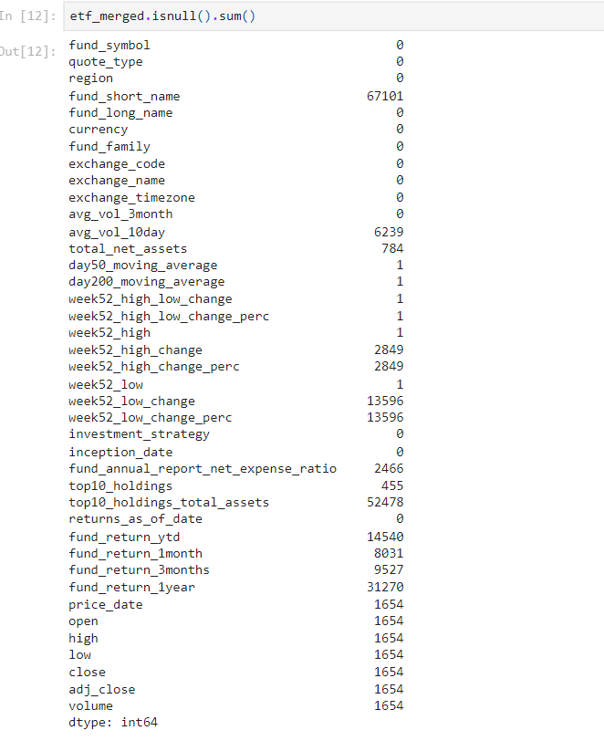

Data Cleaning
The method of repairing or deleting incorrect, corrupted, improperly structured, duplicated, or incomplete data from a dataset is known as data cleaning.
If the data is inaccurate, the results and methods are untrustworthy, even if they appear to be correct

Slide 9
Data Visualization
The visual representation of information and data is known as data visualization.
The practice of putting information into a visual context, such as a map or graph, makes it easier for the human brain to absorb and extract insights.
The primary objective of data visualization is to make identifying patterns, trends, and outliers in huge data sets easier.
Information graphics, information visualization, and statistical graphics are all terms that are frequently used interchangeably.
Data visualization is one of the processes in the data science process that asserts that data must be visualized once it has been collected, processed, and modeled in order for conclusions to be drawn.

Slide 10
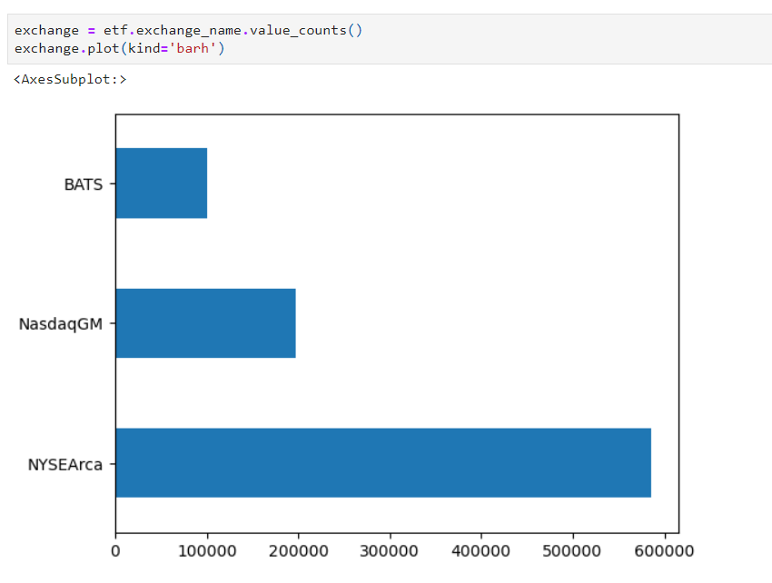
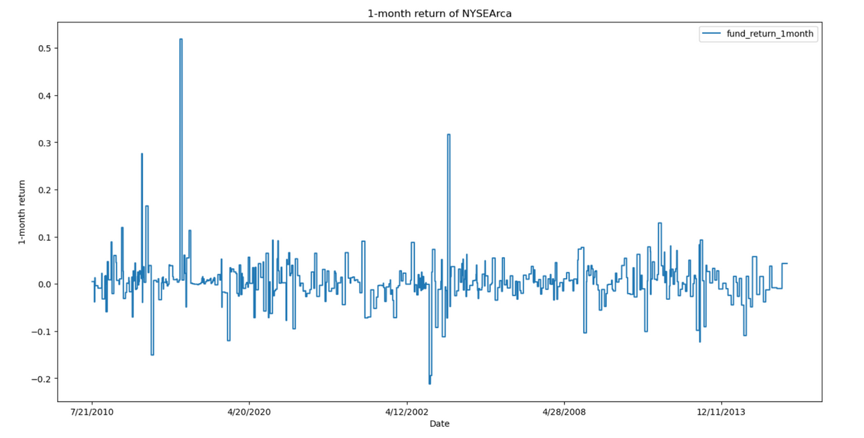
Plotted the three highest value among the ETFs exchange values
Calculated return of NYSE over 1 month's duration

Slide 11
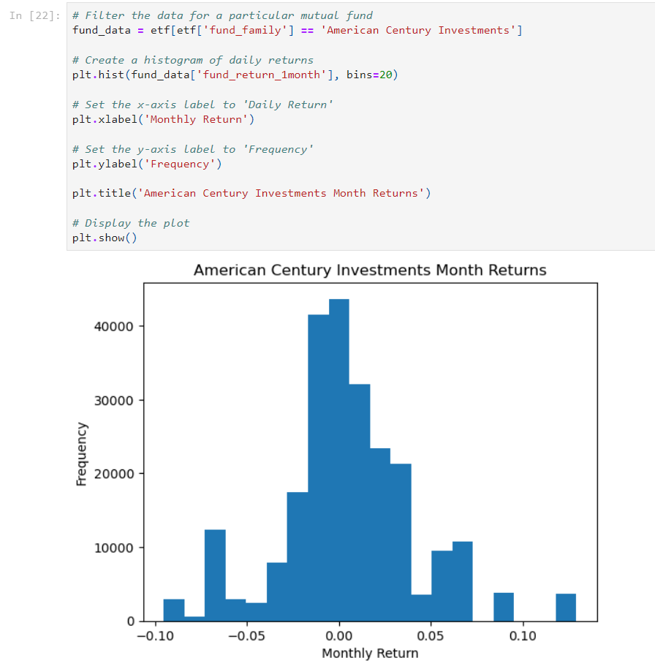
Monthly returns of American Century Investments have been plotted to Analyse the Positive and negative returns

Slide 12
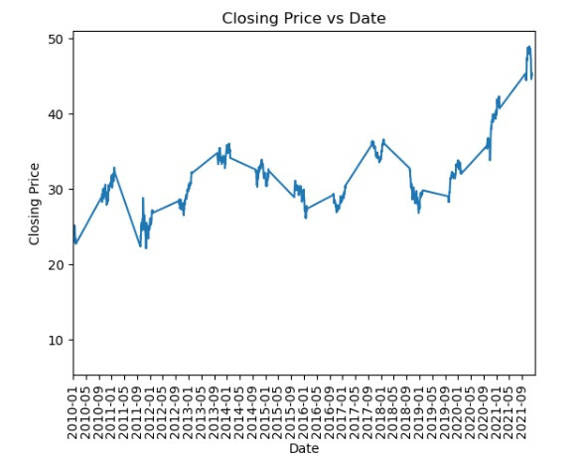
The Closing price of EWD a particular fund symbol has been plotted below over a period from 2010 - 2021

Slide 13
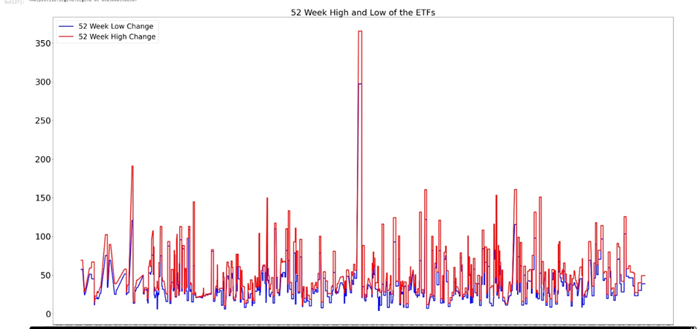
The price analysis for 52 weeks have been plotted which inturn can assist in future prediction of ETF values.

Slide 14
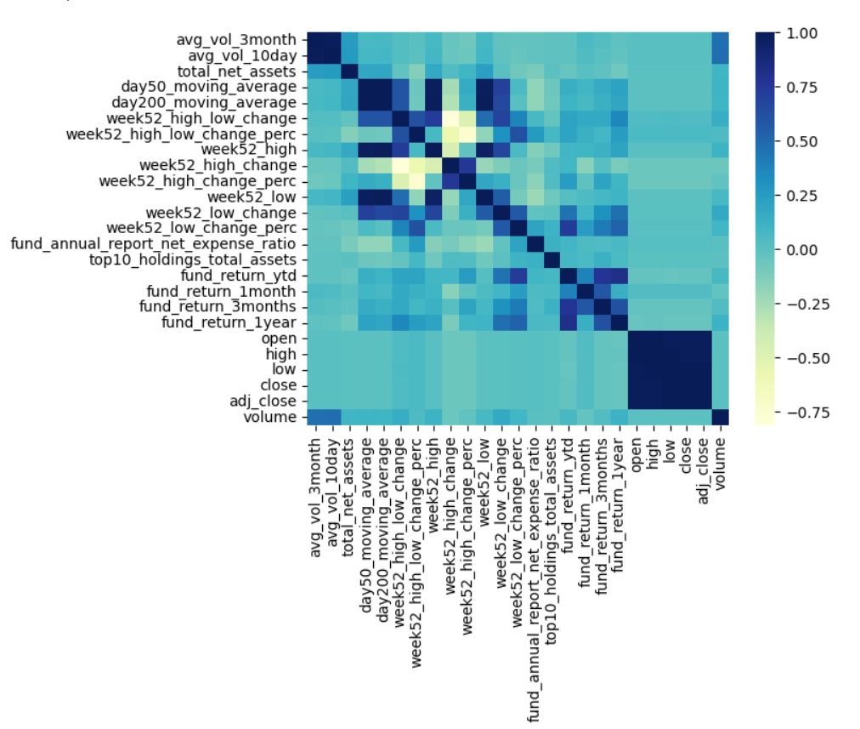
Heatmap helped in the differentiation process.
Through heatmap, we could pick the appropriate attribute for our machine learning algorithm

Slide 15
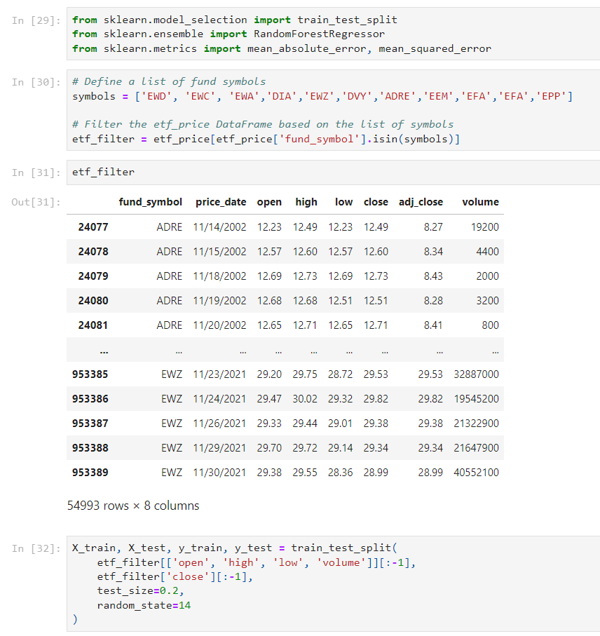
Test train Split

Slide 16
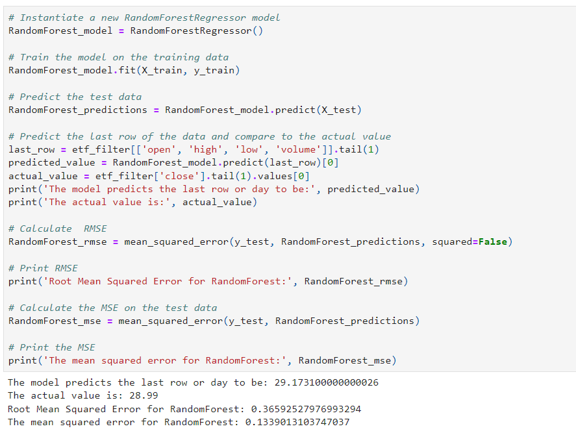

Random Forest
Random forest generates accurate predictions that are simple to understand.
It is capable of effectively handling huge datasets.
The random forest method outperforms the decision tree algorithm in terms of prediction accuracy.
Random Forest works by first understanding decision trees and then applying them to random forests.
Random forest classification uses an ensemble methodology to achieve the desired result.
The training data is fed into several decision trees for training.
This dataset contains observations and features that will be chosen at random during node splitting.

Slide 17
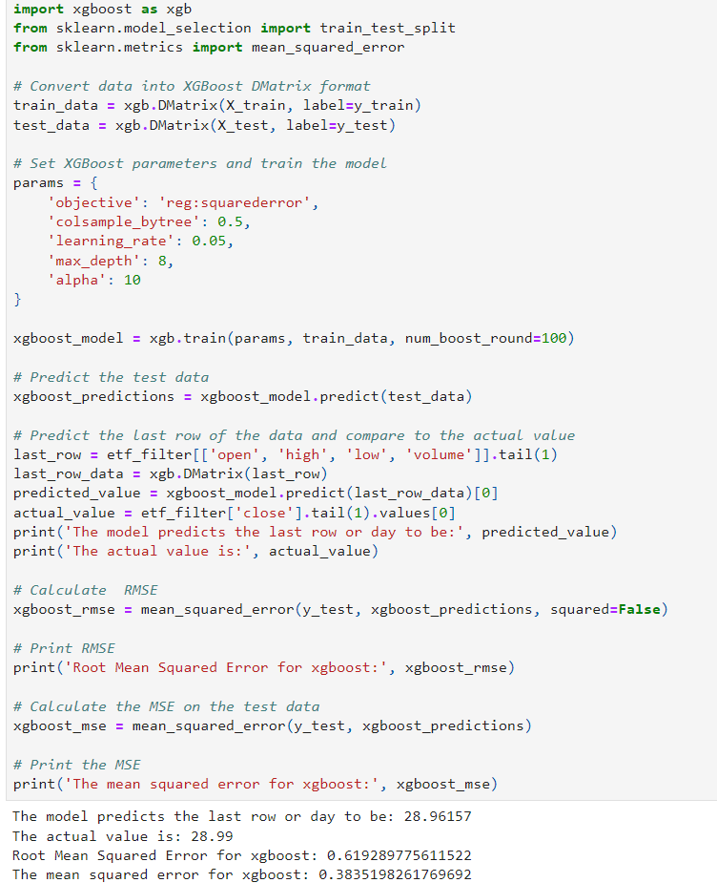
Xg-Boost
The code first imports xgboost and some necessary scikit-learn modules, then it converts the training and test data into the XGBoost DMatrix format. After that, it sets the XGBoost parameters and trains the model with the train_data and the parameters.
Once the model is trained, the code predicts the test data and selects the last row of the data to predict its value. Finally, it calculates the Root Mean Squared Error (RMSE) and Mean Squared Error (MSE) of the model's predictions.
XGBoost is a popular gradient-boosting library that is widely used in various domains, including finance, healthcare, and natural language processing. It has several advantages over other gradient-boosting libraries, such as the ability to handle missing values and regularization techniques to prevent overfitting.

Slide 18
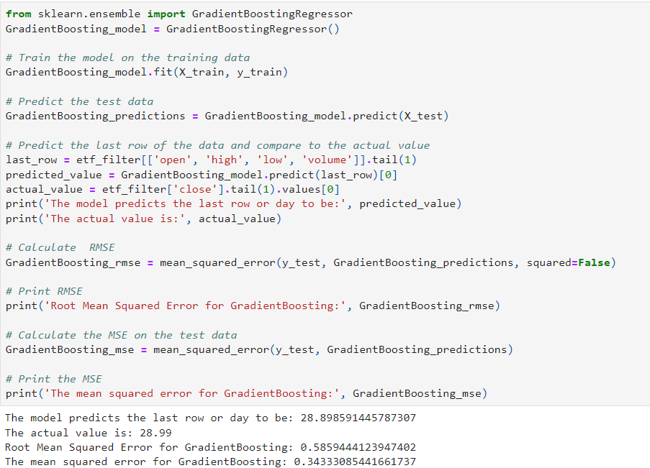
Gradient Boosting Regressor
The code starts by importing the GradientBoostingRegressor from scikit-learn's ensemble module and instantiating a new model.
Then it fits the model on the training data and predicts the test data.
After that, it selects the last row of the data and predicts its value using the trained model. Finally, it calculates the Root Mean Squared Error (RMSE) and the Mean Squared Error (MSE) of the model's predictions.
The RMSE measures the average distance between the predicted values and the actual values, while the MSE measures the average of the squared differences between the predicted and actual values.
A lower RMSE or MSE indicates that the model is more accurate.

Slide 19
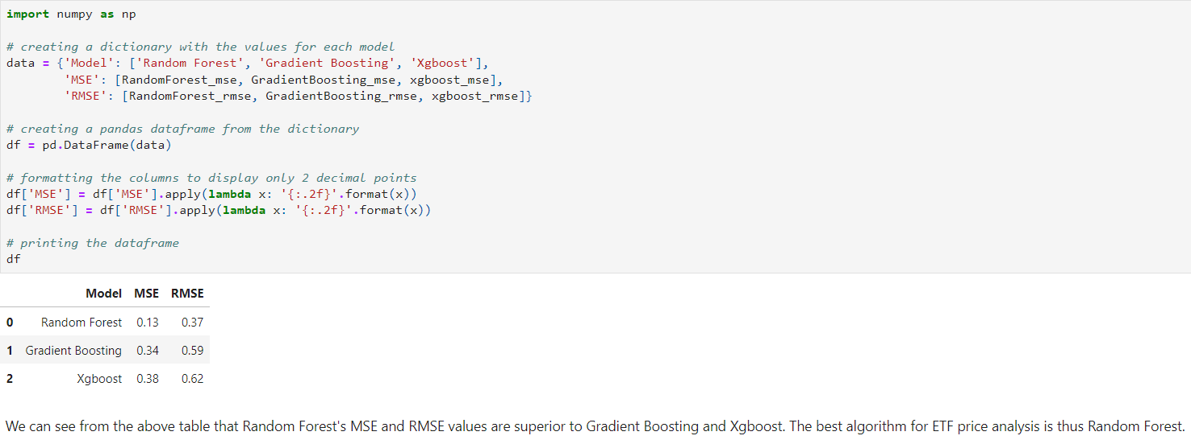
Conclusion:
Based on the results obtained from these models, we can conclude that all three algorithms were able to produce reasonably accurate predictions of ETF prices, as evidenced by their low mean squared error (MSE) and root mean squared error (RMSE) values. However, there were some differences in the performance of the three algorithms, with the Random Forest Regressor generally outperforming the other two models in terms of predictive accuracy.

Slide 20
References:
Breiman, L. (2001). Random forests. Machine Learning, 45(1), 5-32. https://doi.org/10.1023/A:1010933404324
Scikit-learn documentation: https://scikit-learn.org/stable/modules/generated/sklearn.ensemble.RandomForestRegressor.html
Friedman, J. H. (2001). Greedy function approximation: A gradient boosting machine. Annals of Statistics, 29(5), 1189-1232. https://doi.org/10.1214/aos/1013203451
Scikit-learn documentation: https://scikit-learn.org/stable/modules/generated/sklearn.ensemble.GradientBoostingRegressor.html
Chen, T., & Guestrin, C. (2016). XGBoost: A scalable tree boosting system. In Proceedings of the 22nd ACM SIGKDD International Conference on Knowledge Discovery and Data Mining (pp. 785-794). https://doi.org/10.1145/2939672.2939785
XGBoost documentation: https://xgboost.readthedocs.io/en/latest/

